Slide 1
Exploring Dark Networks: From the Surface Web to the Dark Web
Hsinchun Chen, Ph.D., University of Arizona
Panel 3: Multi-Level, High-Dimensional Evolving and Emerging Networks (ML-HD-EEN)
October 12, 2017
“Leveraging Advances in Social Network Thinking for National Security: A Workshop”
Acknowledgements: NSF, DHS, DOJ, DOD

Slide 2
My Background
Academic: Data/computational scientist; data/text/web mining, visualization; applied AI for security and health analytics
Applications: Security analytics; dark networks
Projects: COPLINK (1997-2009, gang/narcotic networks); Dark Web (2001-present, extremist/terrorist networks); Hacker Web (2009-present)
SBE collaborators: M. Sageman, R. Breiger, T. Holt
Agency collaborators: TPD, PPD, FBI, CIA, NSA, DHS (NSF, DOD)

Slide 3
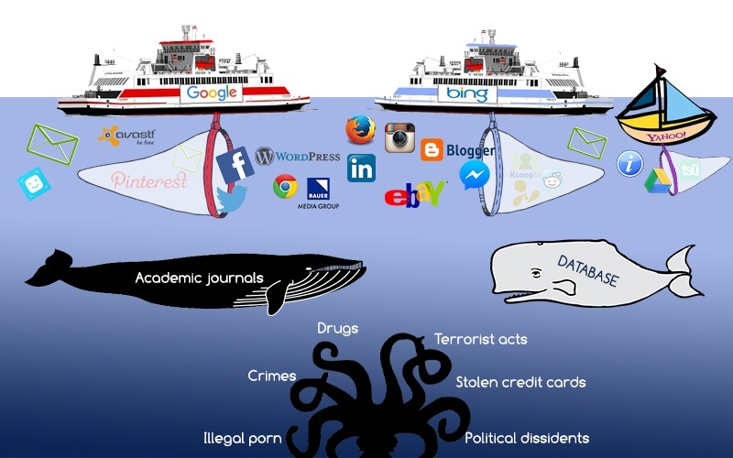
From the Surface Web to the Dark Web
Surface Web
Deep Web
Dark Web
DarkNet
Hacker Web

Slide 4
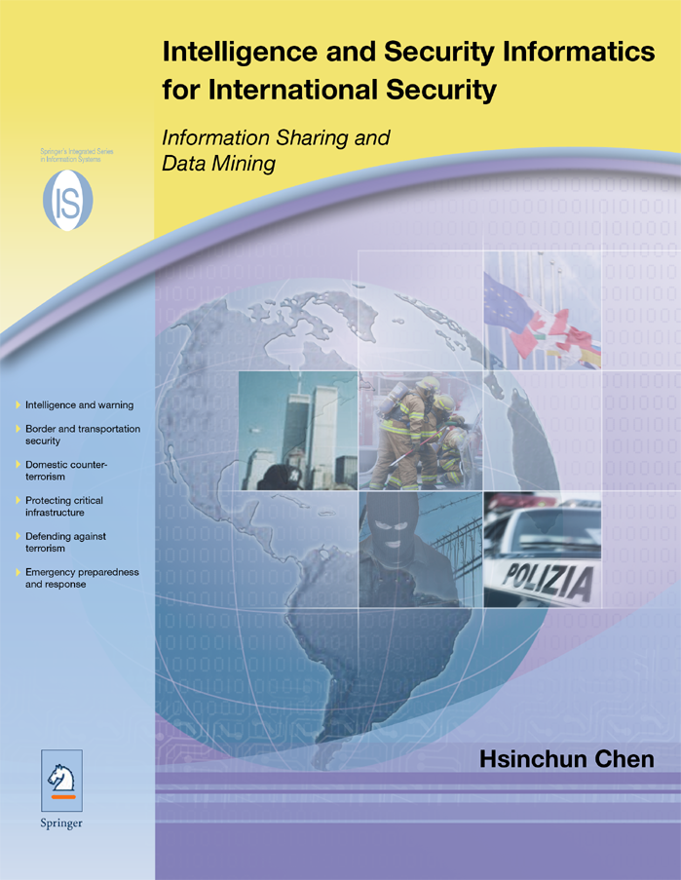
Springer, 2006
Springer, 2012

Slide 5
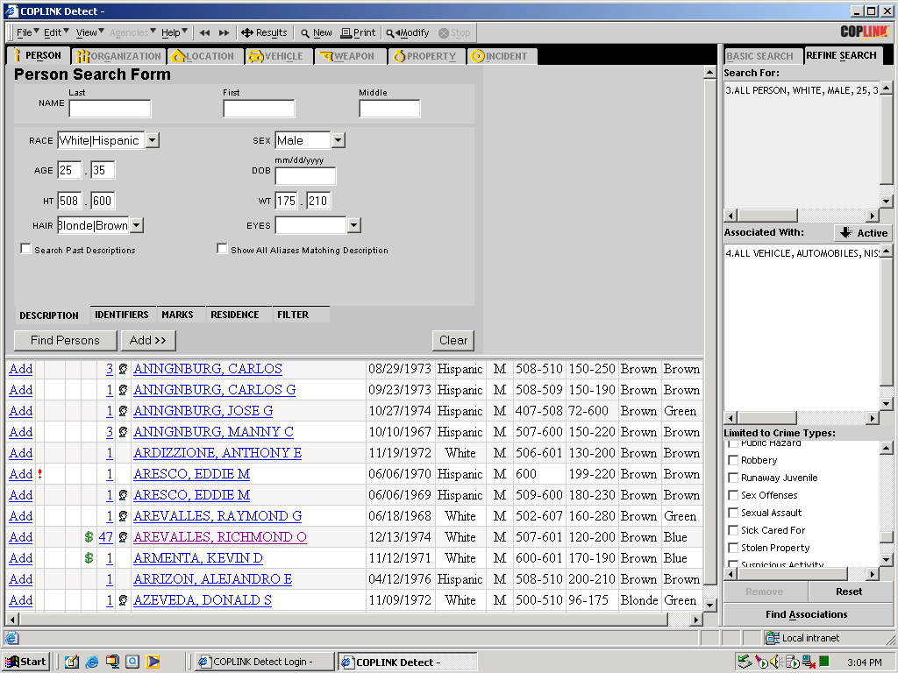
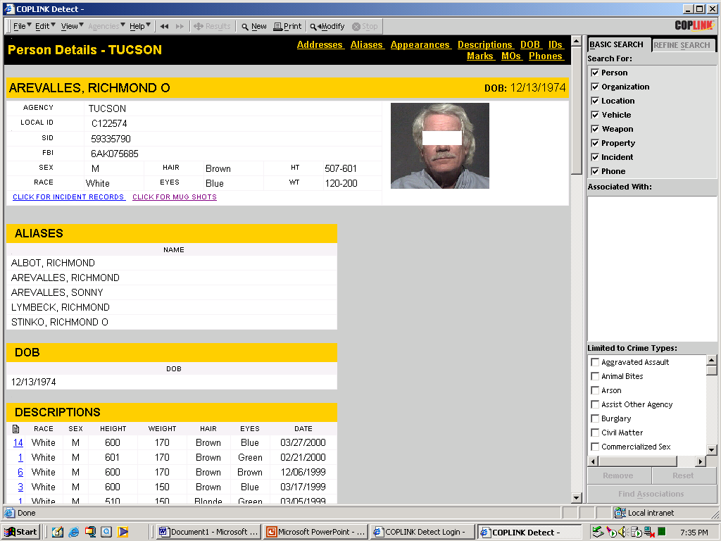
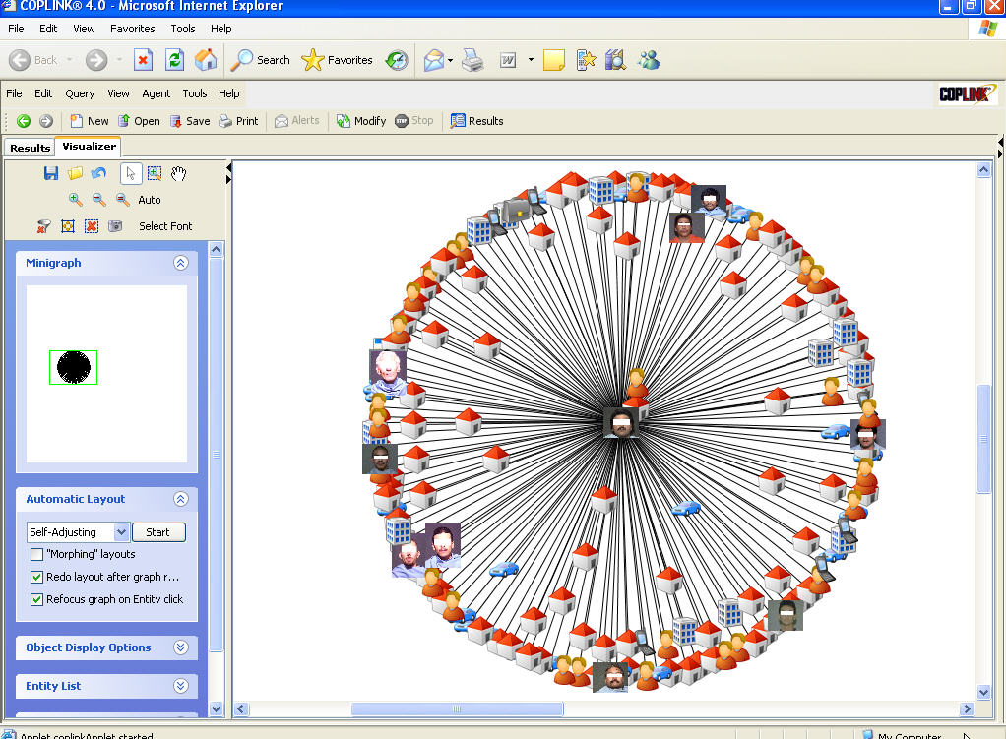
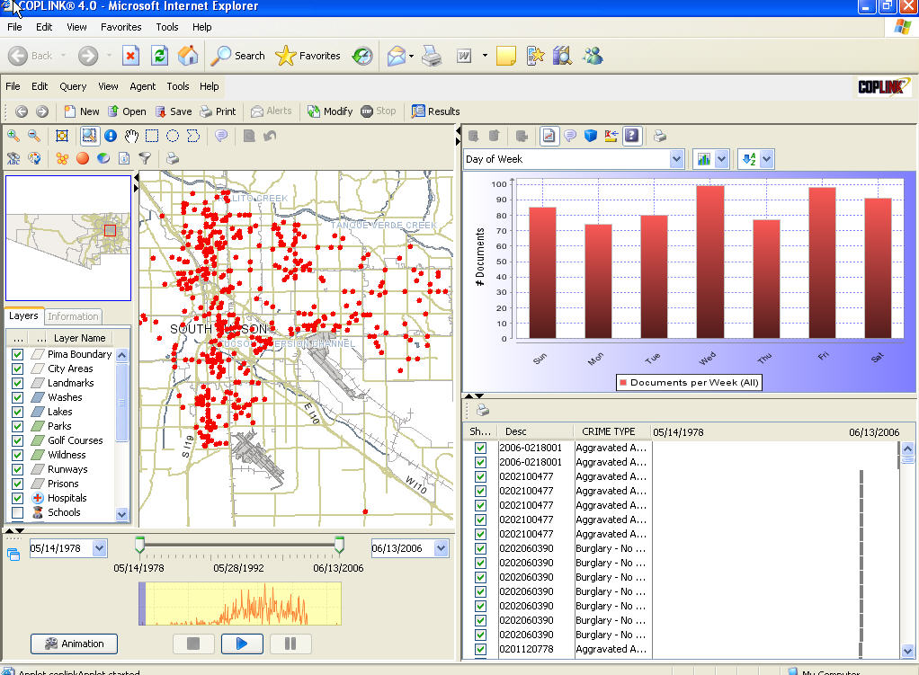
COPLINK: Crime Information Sharing & Data Mining

Slide 6
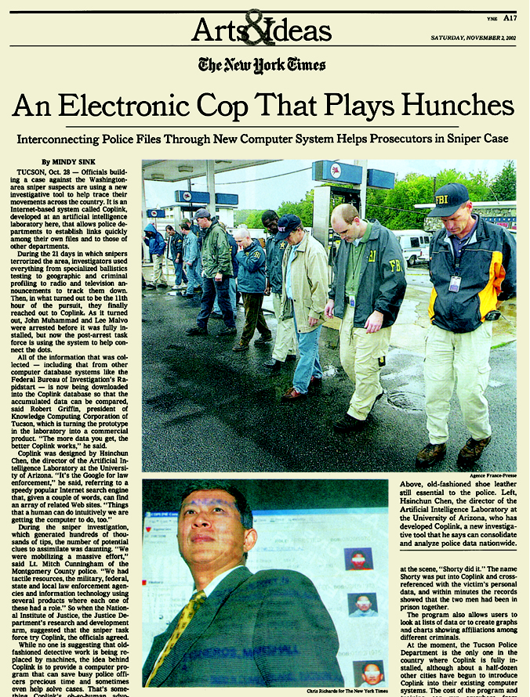

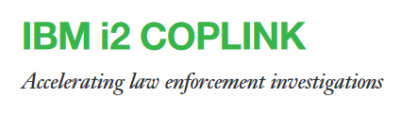


COPLINK: Crime Data Mining
The New York Times, November 2, 2002
COPLINK assisted in DC sniper investigation
ABC News April 15, 2003
Google for Cops: Coplink software helps police search for cyber clues to bust criminals
Washington Post, March 6, 2008
National dragnet is a click away! COPLINK in use in 3,500 police agencies in US!
Merged i2 in 2009; acquired by IBM in 2011 for $500M
($10B, IT unicorn, 2015)

Slide 7
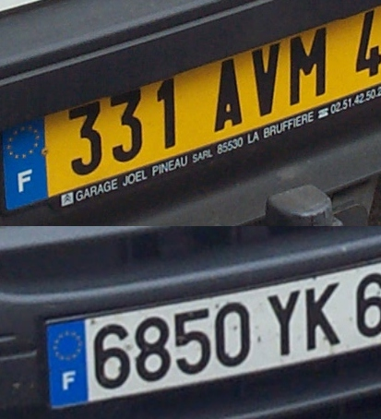
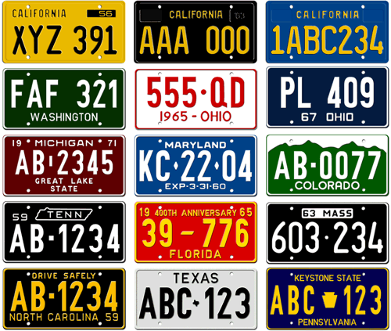
Border Security: High-risk Vehicle Identification (LPR + DM/SNA) ➔ They are watching!
X
X
X

Slide 8
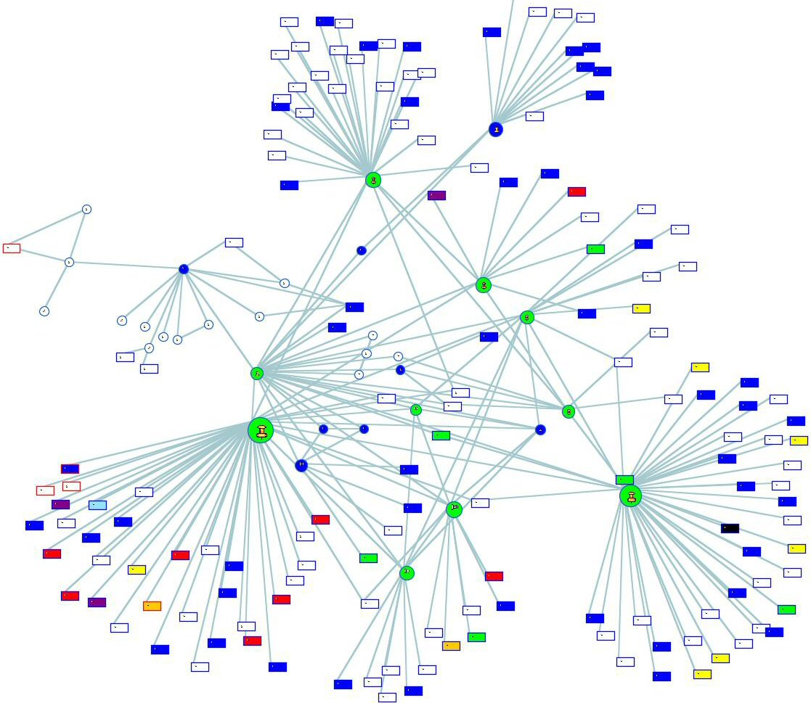
A Vehicle to Watch via its Networks?
Shape Indicates Object Type
circles are people
rectangles are vehicles
Color Denotes Activity History
Larger Size Indicates higher levels of activity
Border Crossing Plates are outlined in Red
Gang related
Violent crimes
Narcotics crimes
Violent & Narcotics

Slide 9
COPLINK Identity Resolution and Criminal Network Analysis (DHS)

Slide 10
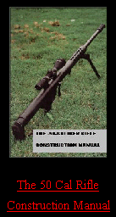
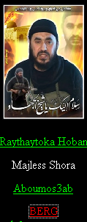
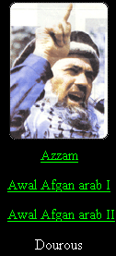
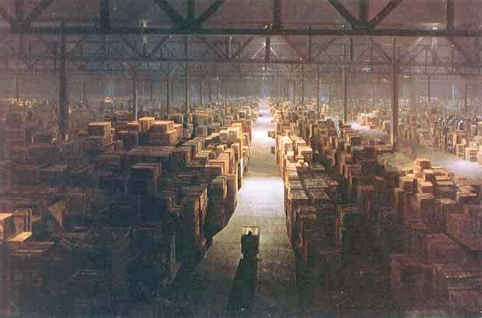
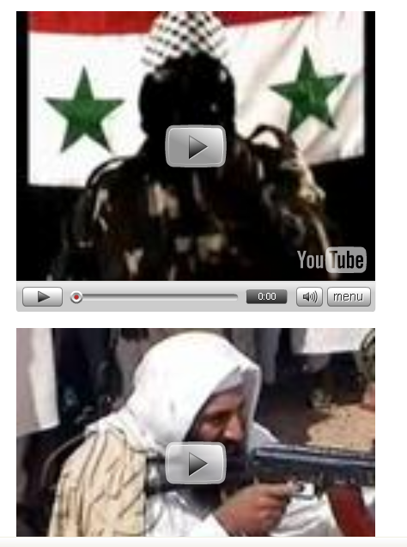
Dark Web Overview
Dark Web: Terrorists’ and cyber criminals’ use of the Internet
Collection: Web sites, forums, blogs, YouTube, etc.
20 TBs in size, with close to 10B pages/files/messages (the entire LOC collection: 15 TBs)

Slide 11
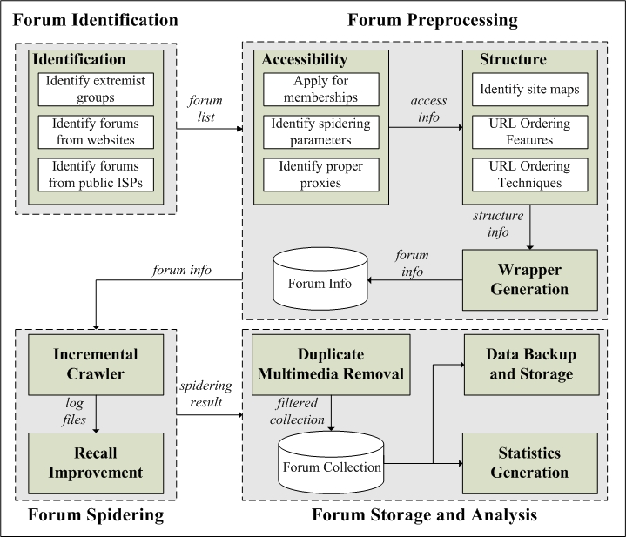
Dark Web Forum Crawler System: Probing the Hidden Web (Proxy, TOR)

Slide 12
CyberGate for Social Media Analytics: Ideational, Textual and Interpersonal Information

Slide 13
Arabic Writeprint Feature Set: Online Authorship Analysis

Slide 14
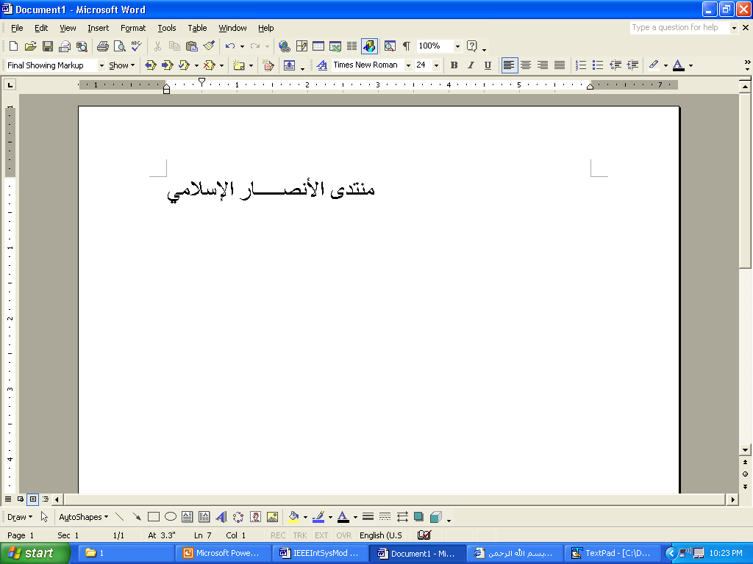

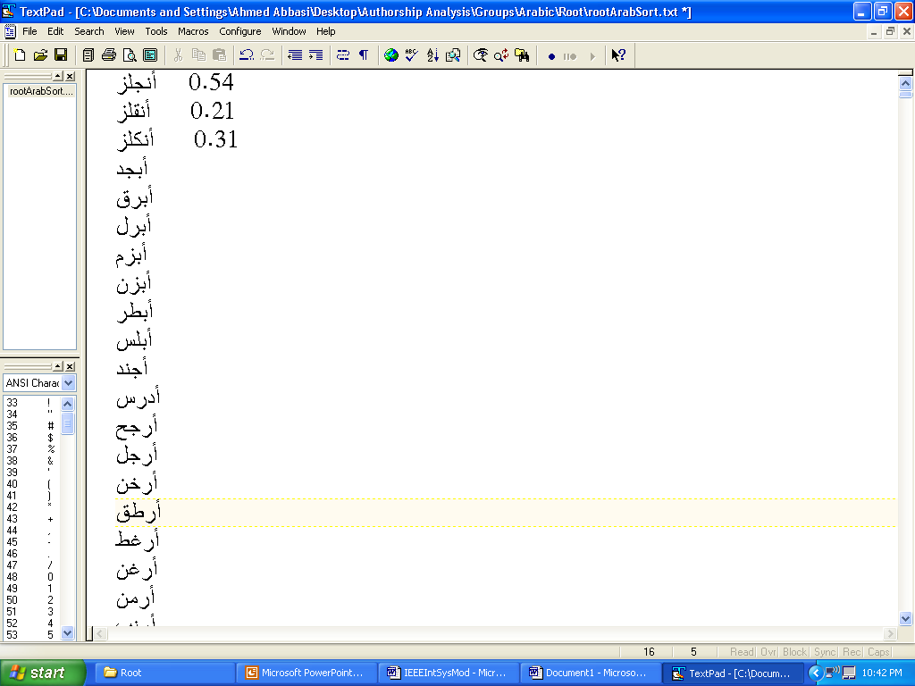
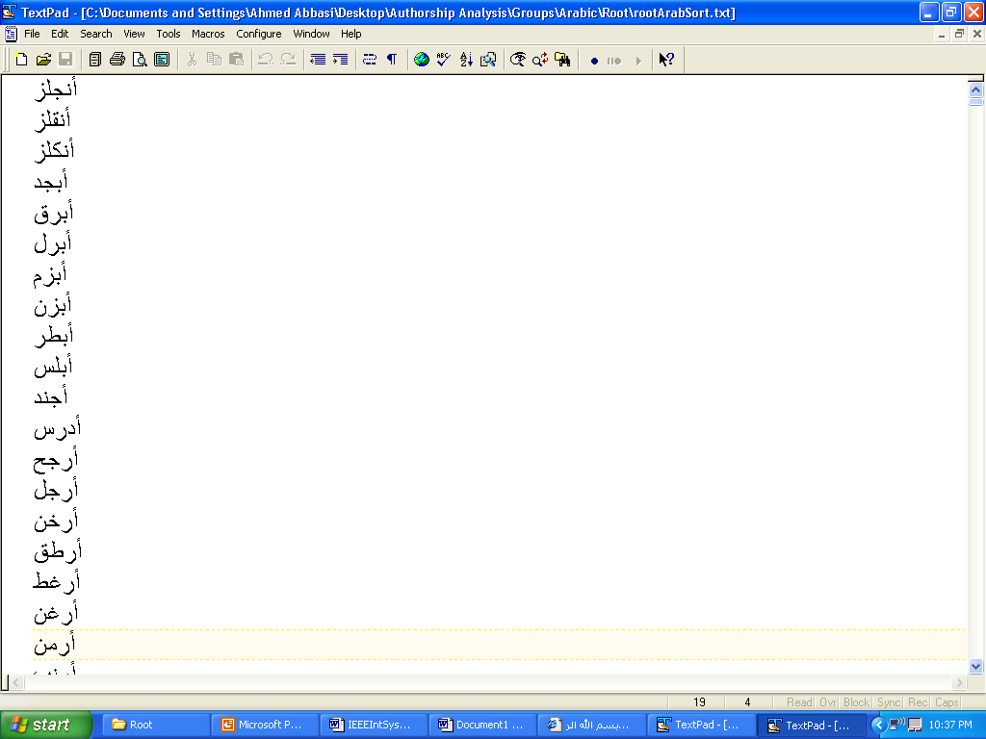
Arabic Feature Extraction Component
1
Incoming Message
Count +1
Degree + 5
2
Elongation Filter
Filtered Message
Similarity Scores (SC)
Root Dictionary
3
Root Clustering Algorithm
max(SC)+1
All Remaining Features Values
Generic Feature Extractor
4

Slide 15
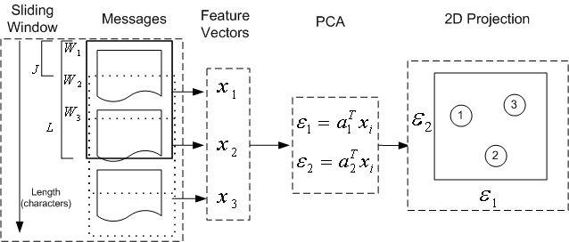
CyberGate System Design: Writeprints

Slide 16
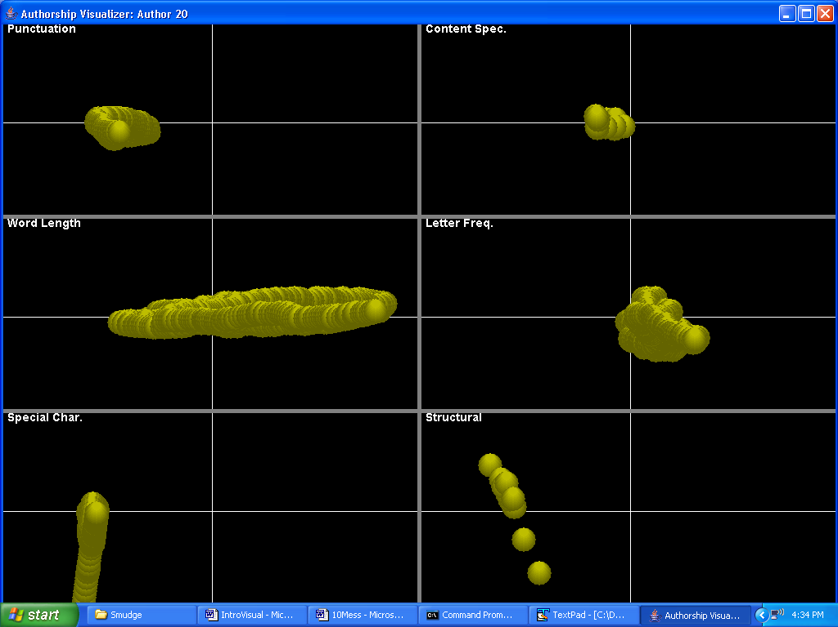
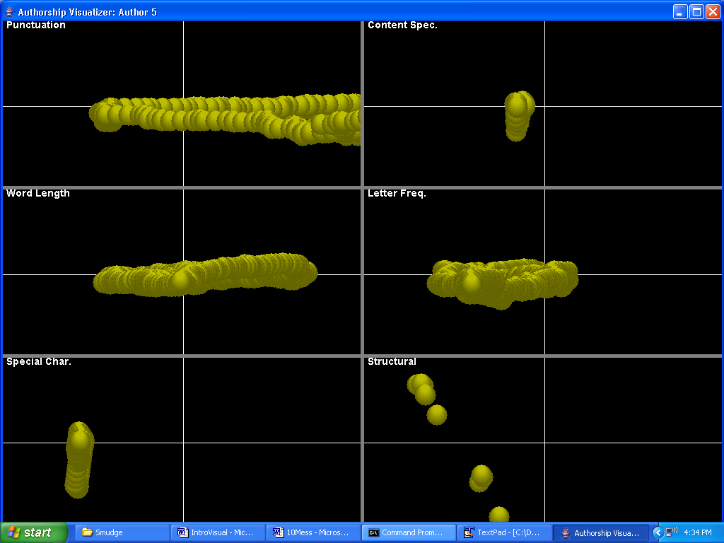
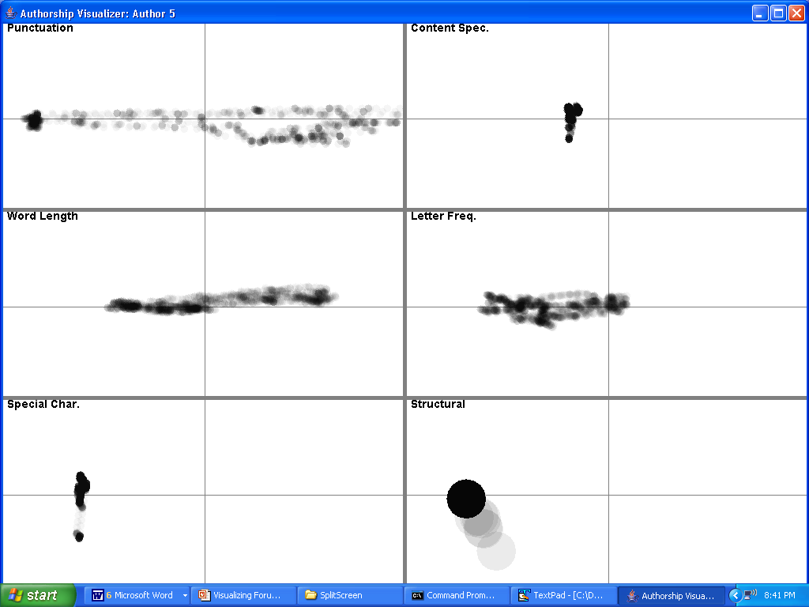
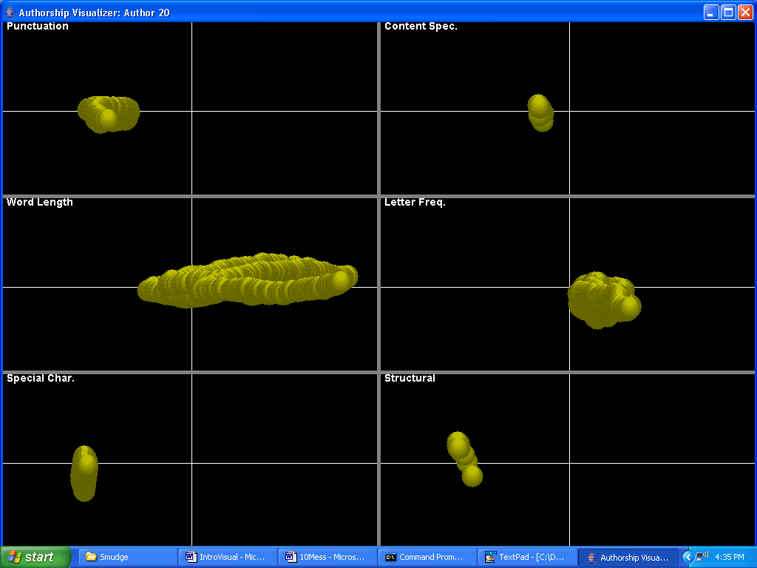
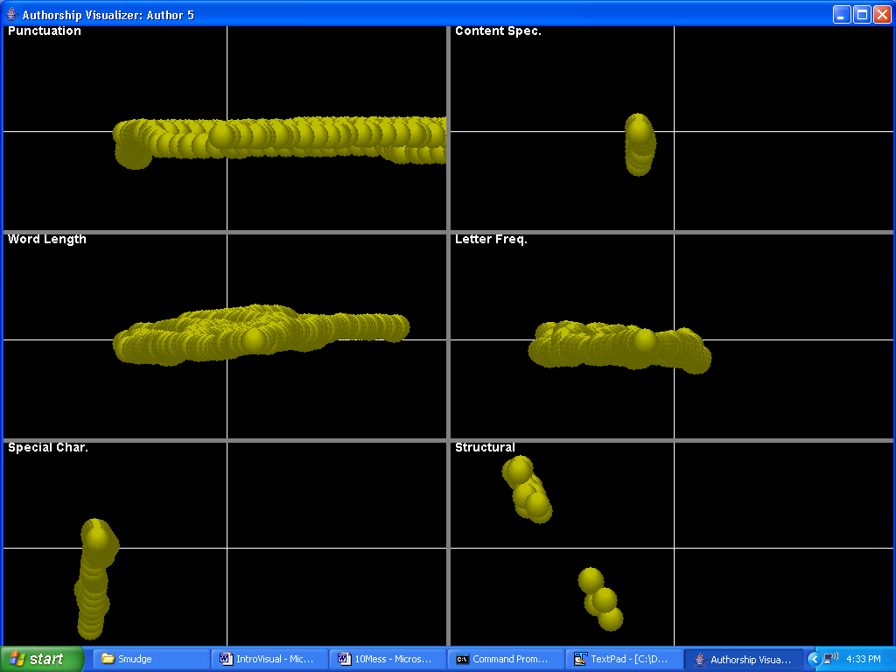
Author Writeprints
Anonymous Messages
Author A
10 messages
Author B
10 messages

Slide 17
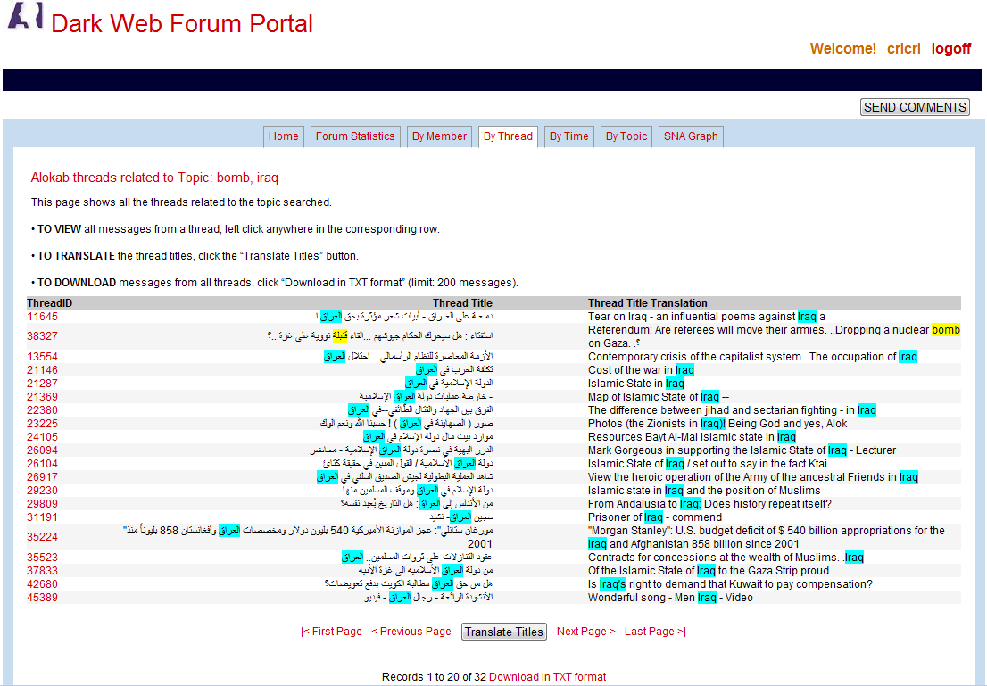
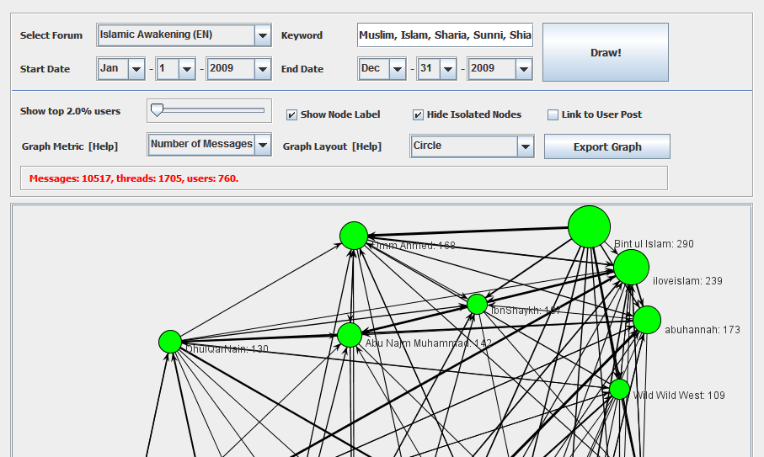
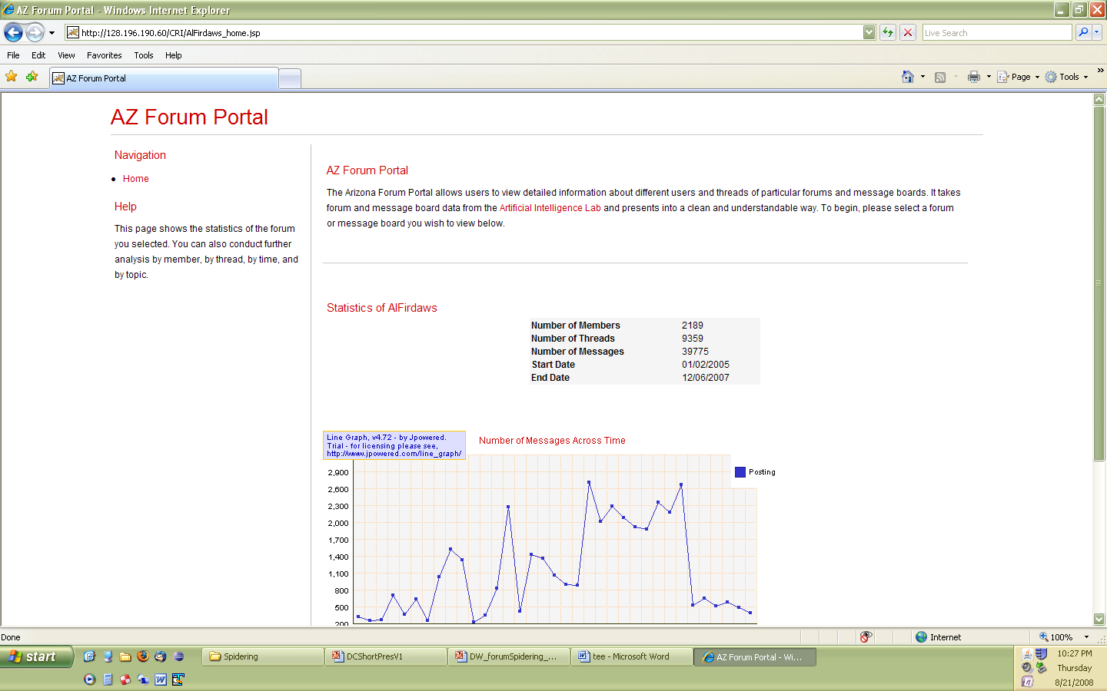
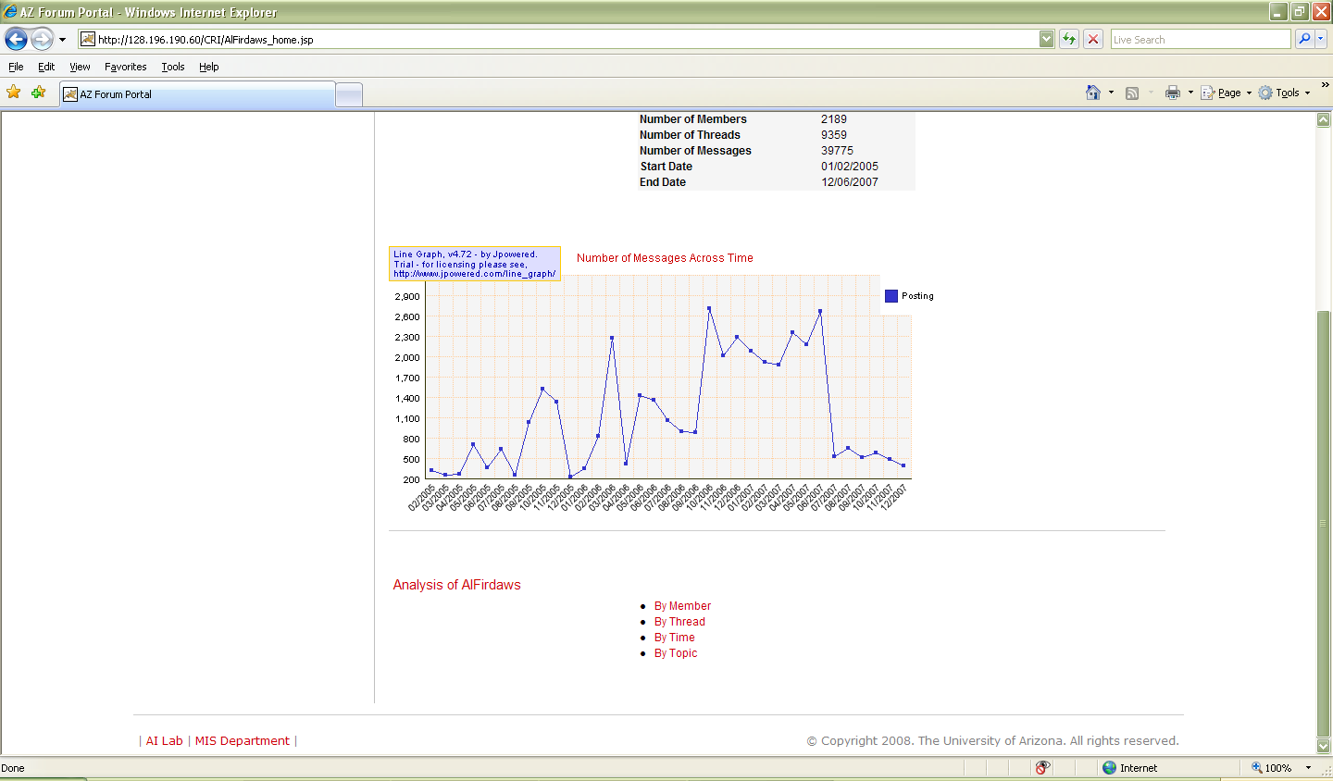
AZ Forum Portal
13M messages (340K members) across 29 major Jihadi forums in English, Arabic, French, German and Russian (VBulletin)
Linking members over time

Slide 18
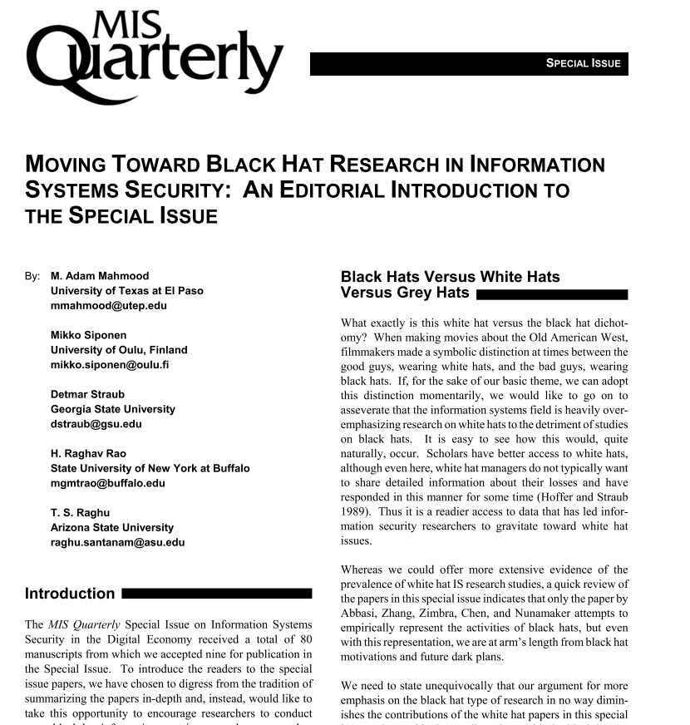
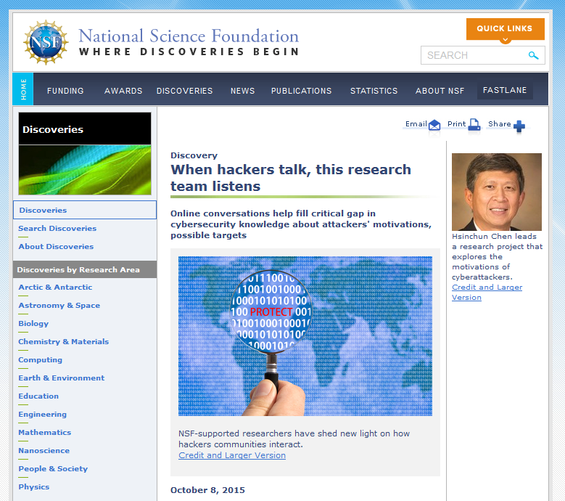
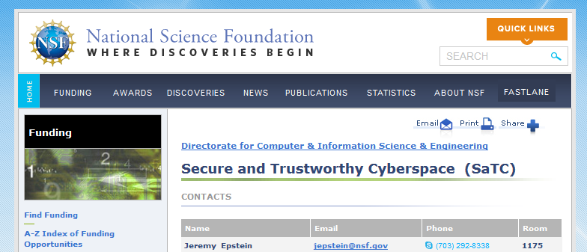
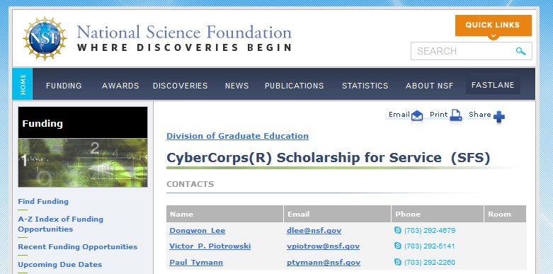

Slide 19
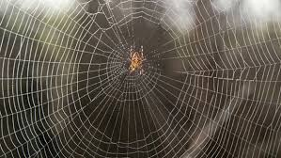

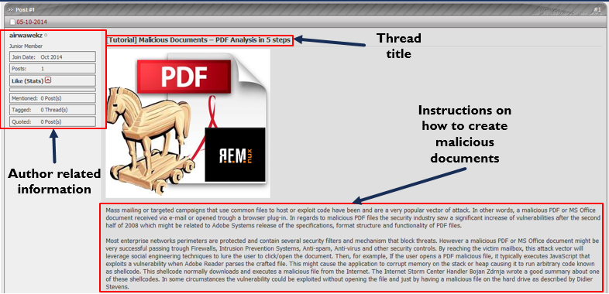
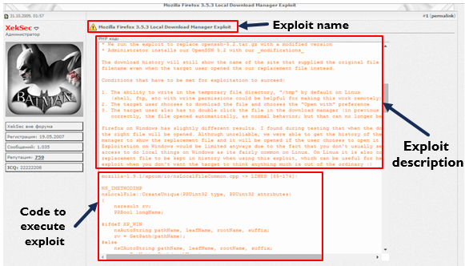
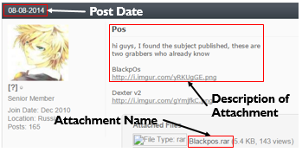

Hacker Web
Hackers and Hacker Assets
Tutorial on how to create
malicious documents
Forum post with source code to
exploit Mozilla Firefox 3.5.3
Forum post with
BlackPOS malware attachment.

Slide 20
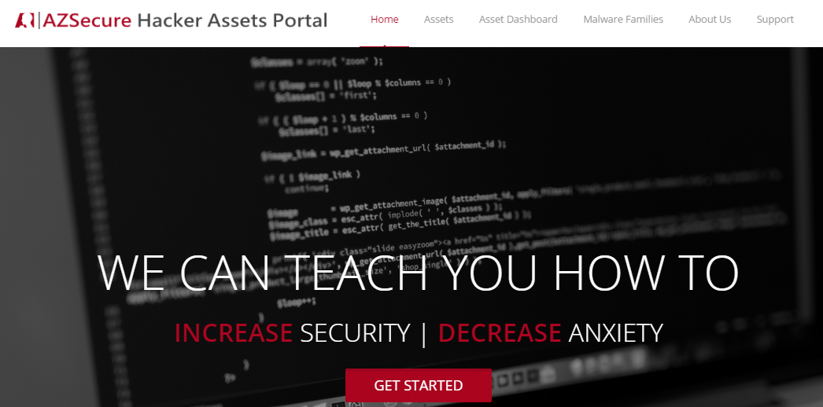
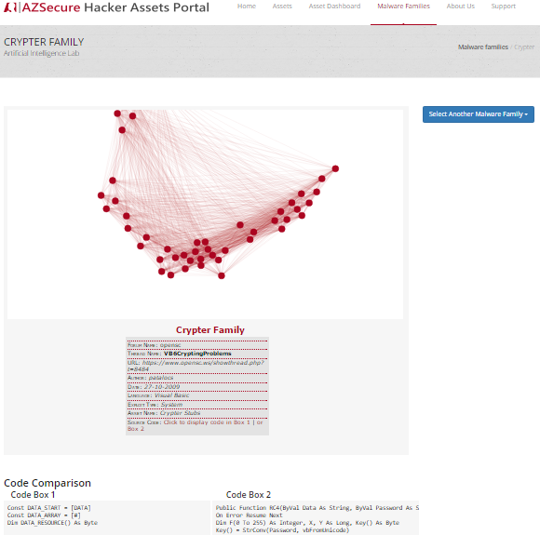
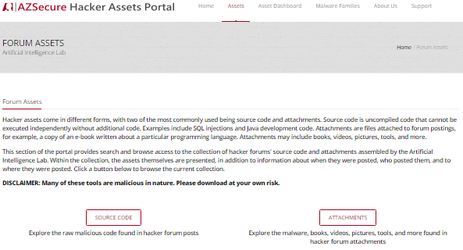
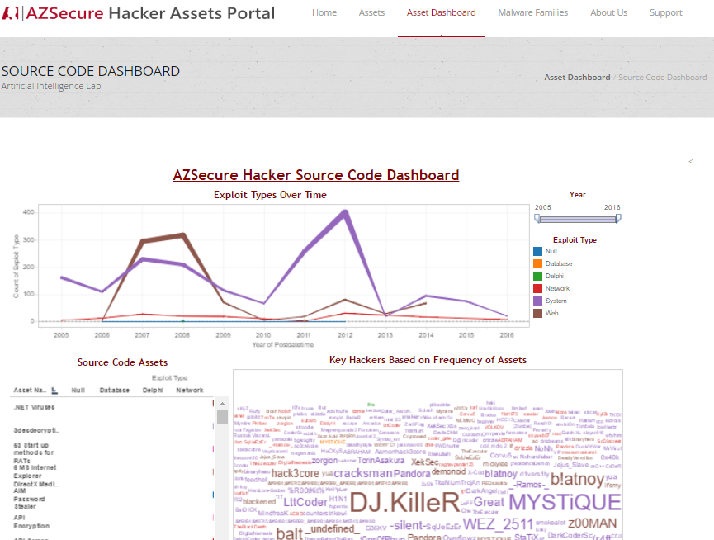
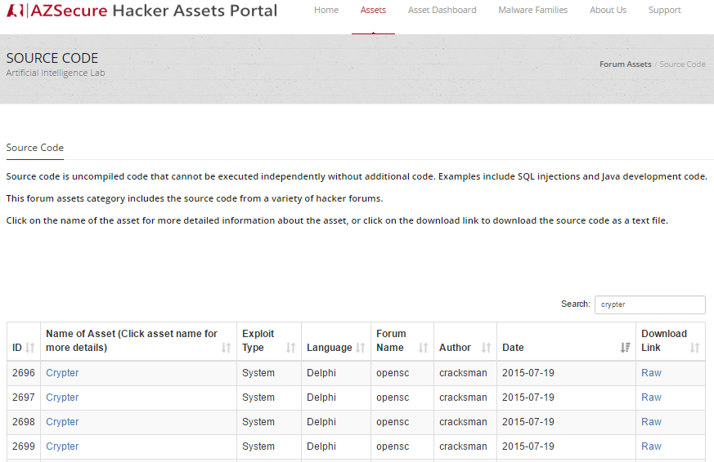
Hacker Assets Portal V2.0 – Overview
(a) Home page, linking to (b & c) Assets, (d) Dashboard, and (e) Malware Families:
(e) Malware Families, for depicting relationships among assets over time (Crypter Family shown)
(b) Assets page, linking to Source Code and Attachments
(c) Source Code page; sortable by asset name, exploit type, date, etc.
(d) Dashboard for drill-down analysis of hackers & assets over time

Slide 21
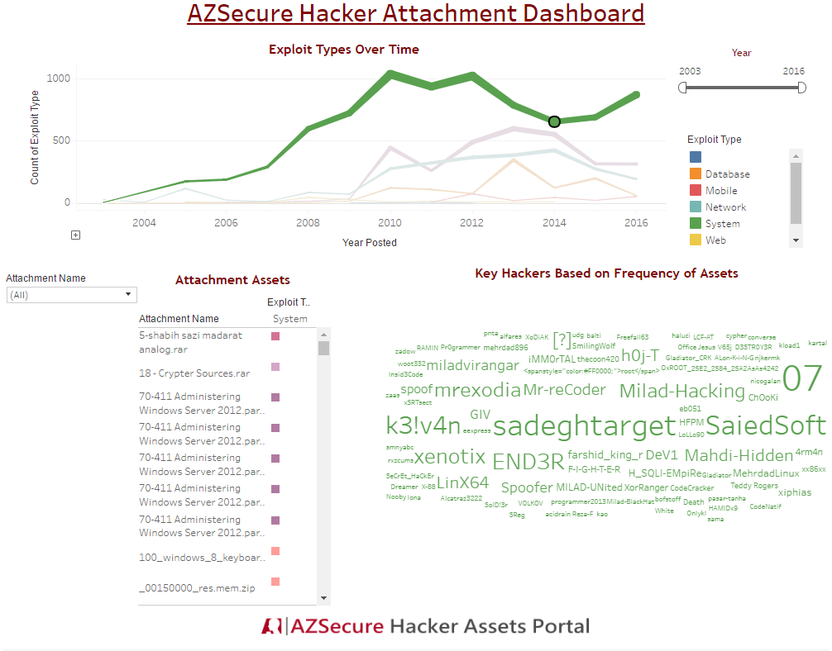
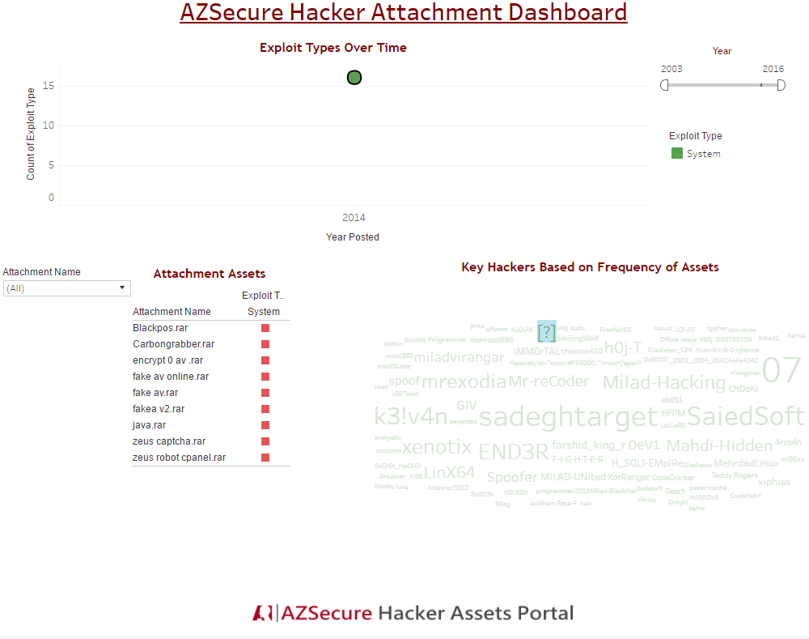
Cyber Threat Intelligence (CTI) Example – Bank Exploits
1
2
Filtering on 2014, when BlackPOS was posted, shows assets and threat actors at that time.
Filtering the actor who posted BlackPOS reveals that he posts other bank exploits (e.g., Zeus).
Provides intelligence on which hacker to monitor.

Slide 22
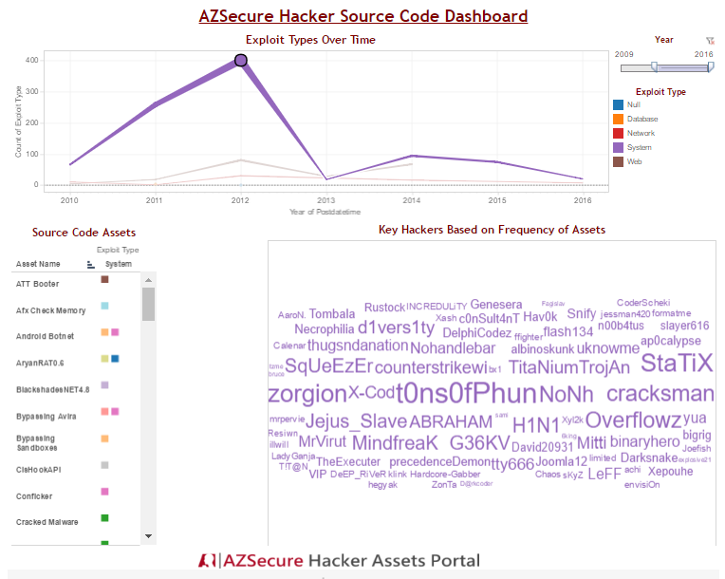
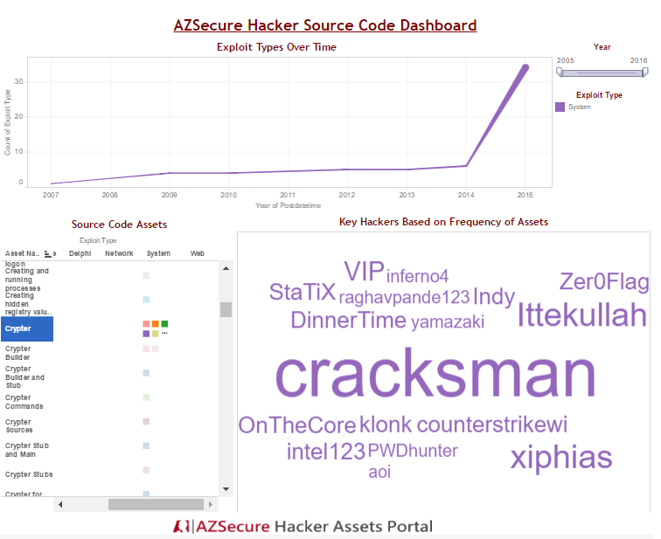
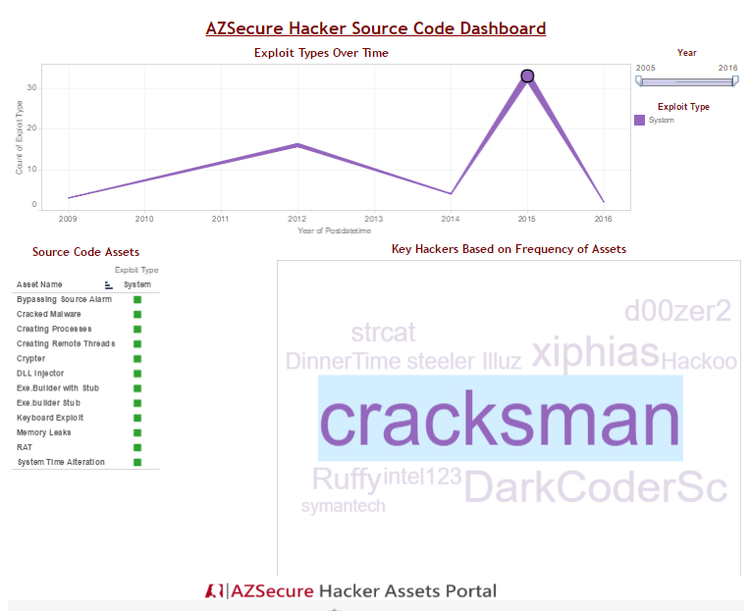
Cyber Threat Intelligence (CTI) Example – Crypters
1
2
3
Filtering on a specific time point (highest peak):
Filtering on a specific asset (crypters, a key technology for Ransomware)
Filtering a specific crypter author (Cracksman) shows the trends and types of assets he posted.

Slide 23
Selected Challenges for ML-HD-EEN in Dark Networks
Identifying data Sources: availability (data stovepipes, data integration; RMS, RDBMS); web OSINT (surface web, deep web, dark web; TOR, ICT); data types (structured vs. unstructured; multi-lingual, multi-media; source code, attachment, tutorial), data biases (noise, deception, adversarial; vigilante, honeypot, APTs)
Recognizing nodes: levels/dimensions (who/what/where/when/why/how); entity extraction and recognition (identity resolution, web authorship analysis, writeprint)
Establishing links: linked by associations (labeled links, probabilistic links); linked by time/space (same-time-same-place; border crossing, hotspot); linked by conversations (linguistic cues and styles; ICT, forums)
Analyzing network patterns: (many SNA techniques)
Tracking changes over time: stream data collection & mining (update & alert; anomaly detection, concept drift; emerging cyber threats and DarkNet Markets

Slide 24
Selected Solutions & Directions for ML-HD EEN
Comprehensive & timely OSINT data collection: from the surface web to the dark web; across level/dimension, over time
Data integration and SNA extraction: AI assisted entity/relationship recognition/integration; across level/dimension, over time
Methodological foundations: dark networks, hidden networks; noise, deception, adversarial intent
Data analytics: advanced social media analytics, stream data mining, adversarial machine learning, BIG DATA analytics; across level/dimension, over time

Slide 25
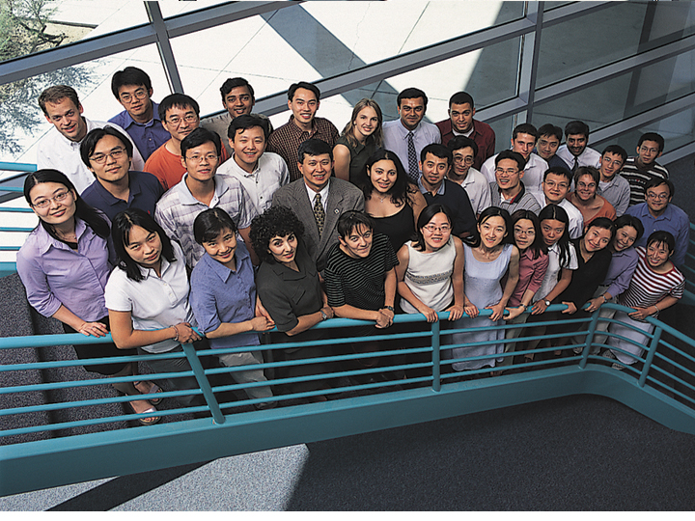
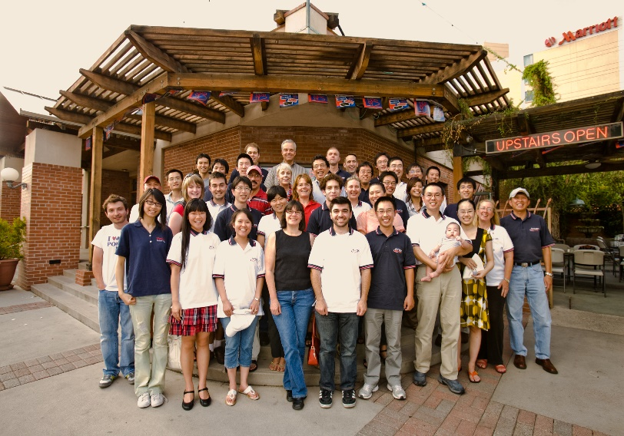

For questions and comments
hchen@eller.Arizona.edu
http://ai.Arizona.edu

